Slide 1

DEPARTMENT OF ELECTRONICS AND COMMUNICATION ENGINEERING
SCHOOL OF ELECTRICAL & COMMUNICATION
10214EC501
COMMUNITY SERVICE PROJECT
SUMMER SEMESTER(2023-2024)
REVIEW - I
“WATER RESOURCE MANAGEMENT”
SUPERVISED BY
Faculty Name : Dr . Joel Devadas Daniel DJ
Designation : Associative professor
PRESENTED BY
1. S.D.S.Prasad (VTU19630) (REG.21UEEC0298)
2. B.Manikanta (VTU21179) (REG.21UEEC0033)

Slide 2
Agenda
ABSTRACT
OBJECTIVE
INTRODUCTION ABOUT VILLAGE
ACTIVITY LOG
SURVEY
SURVEY ANALYSIS WITH REPORT
SOCIETY RELEVANT PROBLEM IDENTIFICATION
NOVEL IDEA GENERATION
PROTOTYPE/DEVELOPMENT OF NEW SOLUTION
GEOTAGGED PHOTOS AND DETAIL&VIDEO LINK
AUTHENTICATED SIGNATURES PROOF AND DETAIL
PLAGIARISM REPORT

Slide 3
ABSTRACT
Managing water resources is really important because it helps us stay alive, keeps nature healthy, and allows us to build our communities. But it's not easy because more and more people are using water, our cities are getting bigger, and the changing climate is making things even trickier. This summary gives you a quick look at the main problems, difficulties, and plans for managing water resources.
First, we discuss the increasing stress on water resources due to a surge in global population, agricultural expansion, and industrial development. Concurrently, climate change-induced shifts in precipitation patterns and the frequency of extreme weather events are exacerbating water scarcity issues.
Next, the abstract delves into the various challenges faced by water resource managers. These challenges include the depletion and contamination of freshwater sources, inequitable access to clean water, and the degradation of aquatic ecosystems. Moreover, the lack of coordinated efforts among stakeholders, outdated infrastructure, and regulatory shortcomings further complicate effective management.

Slide 4
OBJECTIVES
Aim of the Project:
The Aim of the Sustainable Water Resource Management Project is to find smart ways to take care of our water so that it lasts a long time and everyone gets a fair share. We want to solve the tricky problems that come with managing water, like making sure our environment stays healthy, helping our economies grow, and making life better for the people who rely on water.
Scope of the Project:
Water Conservation and Efficiency:
The project will focus on promoting water conservation practices and the adoption of water-efficient technologies in various sectors, including agriculture, industry, and households.
Water Quality Management:
The project will address issues related to water contamination by implementing water treatment technologies and pollution control measures. It will also involve regular water quality testing and monitoring.

Slide 5





















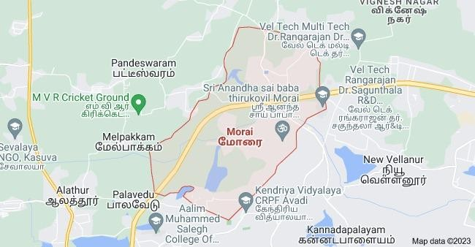
Morai is a village in Ambattur Taluk, Tiruvallur District, Tamil Nadu, India. It is located in the western suburb of Chennai, about 23 kilometres away from the city center. As of 2011, it had a total population of 10,873.
Geography
Morai is located on the banks of Krishna Water Canal, covering an area of 11.63 square kilometres.Chennai Outer Ring Road passes through the village.Its average elevation is 27 metres above the sea level.
Climate
Morai has a Tropical Savanna Climate (Aw).
It sees the least amount of precipitation in February, with an average rainfall of 8 mm; and the most precipitation in October, with an average rainfall of 191 mm.

Slide 6
ACTIVITY LOG
Day/Date | Brief Description of the daily activity | Learning Outcome
28-09-2023 | Conducted survey in the village | Enquire about there relevant problems
29-09-2023 | Discussed with the people in the village about water reated issues. | Identified the issues which leads to the problems
30-09-2023 | Identified the problem and framed out the objective | Objectives
01-10-2023 | Framed methodology and finalized the project solutions | Solutions for their problems

Slide 7
SURVEY
As a part of our project –Water Resource Management ,the survey is conducted in the village(morai).
We have been gone through a village and asked the villagers about the water sources.
How the water is using for the fields.
Is there any water wastage while they are using it.
Is there any shortage of water for the fields.
Are you using any type of modern technology in the fields.
Are you aware of water management and modern technology involved of water usage .
*With Hardcopy Screen Shot

Slide 8
SURVEY ANALYSIS
For the village, There is no water resources like rivers , to flow through out the year.
We have been noticed that the water sources are running out mostly in the fields.
Some of the fields are not even getting the water sources.
There is no modern technology involved in the fields on basis of water technology.
Introducing the moisture sensors and sprinkler will change the over usage of the water for the fields and saves water .

Slide 9
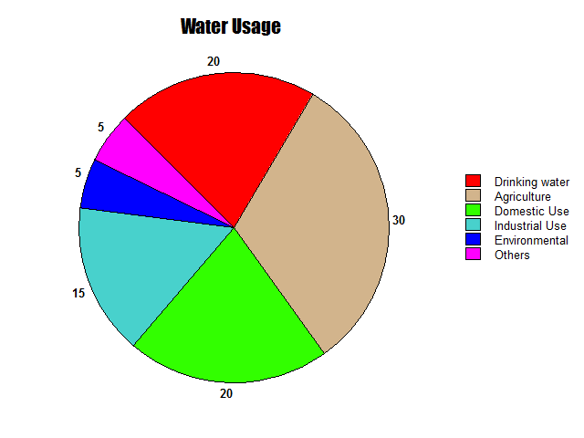
SURVEY ANALYSIS
This Pie-Chart Represents the usage of water in the Morai Village

Slide 10
SOCIETY RELEVANT PROBLEM IDENTIFICATION
These Provide a clear and concise overview of the societal problems in village :
Contaminated Water Sources:
Pollution from agricultural runoff, industrial discharge, or inadequate sanitation facilities can contaminate water sources, making them unsafe for consumption.
Insufficient Water Supply:
Water scarcity is a significant problem in many villages, often exacerbated by factors such as climate change, droughts, and over-extraction of groundwater.
Unsustainable Water Use:
Over-extraction of groundwater, often driven by agricultural demands, can lead to the depletion of water resources and land subsidence.
BATCH NO: DEPARTMENT ELECTRONICS AND COMMUNICATION ENGINEERING

Slide 11
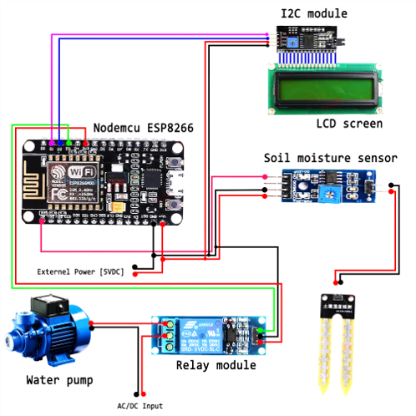
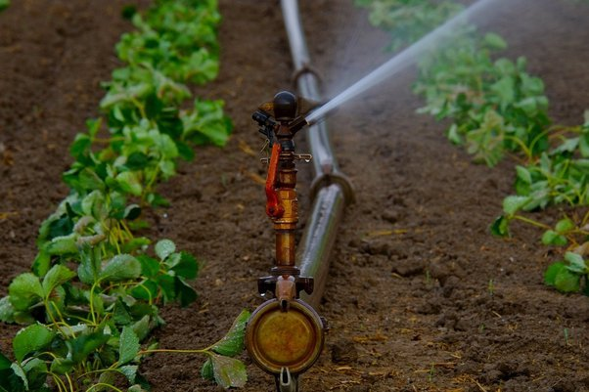
PROTOTYPE/DEVELOPMENT OF NEW SOLUTION
Sprinkler irrigation using Moisture sensors
BATCH NO: DEPARTMENT ELECTRONICS AND COMMUNICATION ENGINEERING

Slide 12
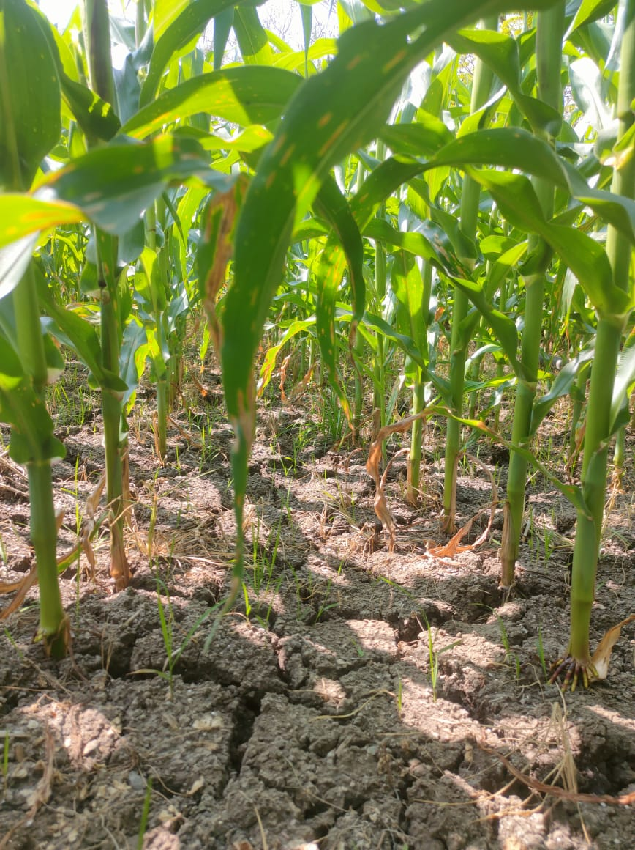
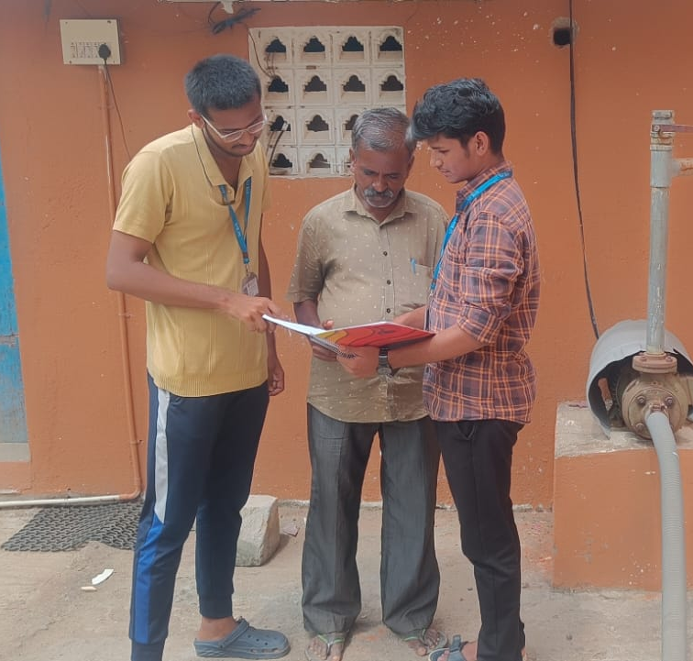
PHOTOS :-
01/10/2023 10:00 GMT +05:30
BATCH NO: DEPARTMENT ELECTRONICS AND COMMUNICATION ENGINEERING

Slide 13
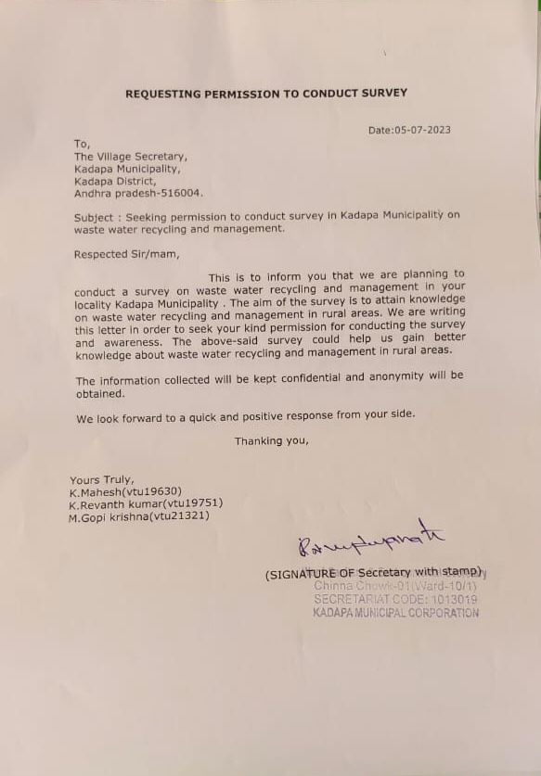
AUTHENTICATED SIGNATURES PROOF AND DETAIL.
Sample.1
BATCH NO: DEPARTMENT ELECTRONICS AND COMMUNICATION ENGINEERING

Slide 14
RECOMMENDATIONS AND CONCLUSIONS OF THE COMMUNITY SERVICE PROJECT.
By addressing diverse water sources such as households, drainage, and agriculture, the CSP project provides an integrated approach to water resource management.
The water resource management project represents a significant step towards a more sustainable and responsible approach to water resource utilization.
Through the development of effective treatment systems, the establishment of sprinkler irrigation, and active community engagement, Not only improved the quality of water resources but also contributed to environmental protection, public health Enhancement, and cost-effective Water management.
BATCH NO: DEPARTMENT ELECTRONICS AND COMMUNICATION ENGINEERING

Slide 15
PLAGIARISM REPORT
Title: Water Resource Management and Sprinkler Irrigation
Introduction
Water resource management is a critical aspect of sustainable agriculture. One effective method of water distribution in agriculture is sprinkler irrigation. This report discusses the importance of water resource management in agriculture and the benefits of sprinkler irrigation as a water-efficient technology.
Sprinkler Irrigation
Definition - Sprinkler irrigation is a method of applying water to crops in the form of droplets, like rain, through a network of pipes and pumps.
Water Efficiency
Energy Efficiency
Improved Crop Quality and Yield
Flexibility and Adaptability
Reduced Labor and Maintenance
Conclusion
Efficient water resource management in agriculture is crucial for ensuring food security and environmental sustainability. Sprinkler irrigation is a valuable tool in this endeavor, offering numerous benefits, including water and energy efficiency, improved crop quality, and adaptability. However, successful adoption of sprinkler irrigation requires careful planning, investment, and ongoing maintenance to address the challenges associated with this technology. Sustainable water management practices and innovative irrigation methods are key components of ensuring a resilient and productive agricultural sector in the face of water resource challenges.
BATCH NO: DEPARTMENT ELECTRONICS AND COMMUNICATION ENGINEERING

Slide 16
THANK YOU
BATCH NO: DEPARTMENT ELECTRONICS AND COMMUNICATION ENGINEERING

